Slide 1
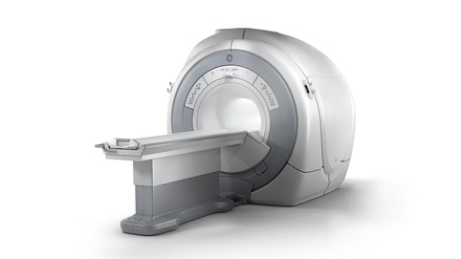
High-end medical imaging equipment
o CT overview
o MRI overview
o PET overview
o Nuclear medicine overview
18.6.8 Highly specialised medical imaging equipment
Unit C18.6 Maintaining Medical Imaging Equipment
Module 279 19 C Medical Instrumentation II
©
dr. Chris R. Mol, BME, NORTEC, 2016

Slide 2
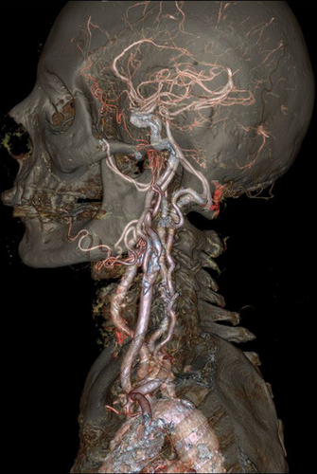
High end Medical Imaging Equipment
Various new Imaging technologies have been developed over the last 50 years or so.
Different imaging technologies create images of different aspects of the human body, e.g. ultrasound reflection, X-ray absorption, magnetic resonance properties etc.
Therefore, each imaging technology has its own strength and weaknesses. Medical doctors, supported by clinical engineers, have been finding out what imaging technology best to use for various body segments and diseases. For example, ultrasound is preferred for fetal imaging, X-ray for bone fractures, MR for brain scans, Nuclear Medicine for some types of cancer.
In the (local) absence of the optimal imaging method for an application, lower cost methods will often offer a reasonable alternative.
composite image with data from different imaging technologies
©
High-end Medical Imaging
dr. Chris R. Mol, BME, NORTEC, 2016

Slide 3
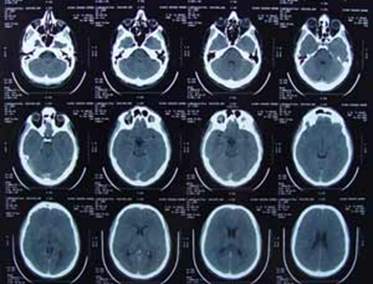
CT
Computerized Tomography
‘calculated’
with a computer,
rather than directly recorded on film
cross-sectional images (tomograms)
rather than ‘projection’ images
dr. Chris R. Mol, BME, NORTEC, 2016

Slide 4
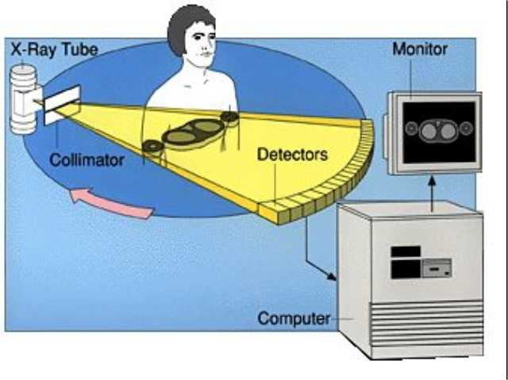
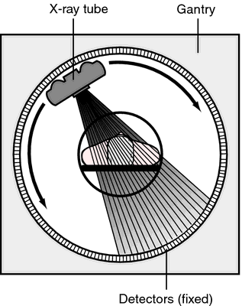
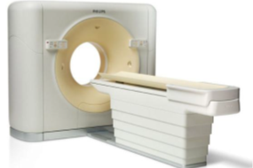
CT: principles
An X-ray tube with opposite X-ray detectors are built into a scanner (gantry) are rapidly rotating around the patient.
The scanner measures how much X-ray is passing through the patient along thousands of different projection lines.
From these many data, the X-ray absorption in each position in a cross-section of the patient is calculated.
In the resulting CT image, each pixel indicates the X-ray absorption at that location: high absorption for bone, low for air, intermediate for various soft tissues.
©
Biological Signal Processing
dr. Chris R. Mol, BME, NORTEC, 2015

Slide 5
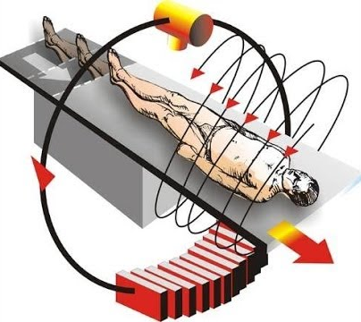
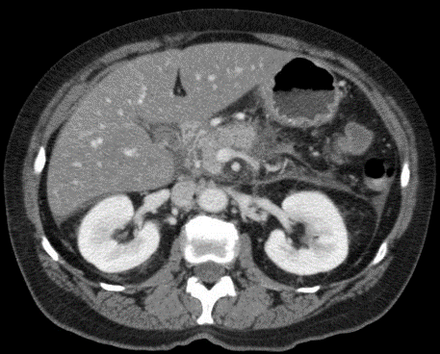
CT principles
CT is used in a wide variety of imaging exams, including spine and head, abdomen and vascular.
In CT, tissues are not super-imposed, as in X-ray Radiography, avoiding the ‘3D problem’.
CT gives improved resolution versus standard (projection) X-ray, at the cost of a (typically 100x) higher absorbed X-ray radiation dose.
X-ray absorption is not very different for different soft tissues. Therefore, CT is not the ‘modality of choice’ in some applications (e.g. brain scans, where MR can better differentiate between different brain tissues – and tumours).
Spiral scan: moving the patient table during data acquisition yields data for a stack of tomograms
CT image of the abdomen, clearly showing spine, ribs, kidneys and liver
©
Medical Imaging
dr. Chris R. Mol, BME, NORTEC, 2016

Slide 6
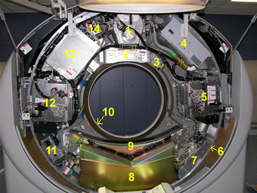
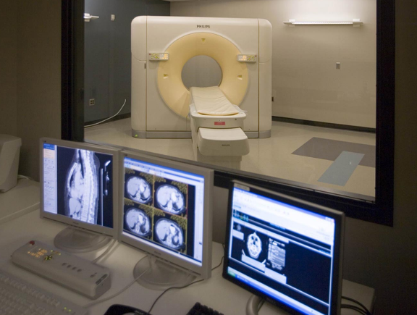
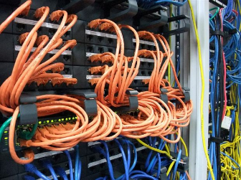
CT components
x-ray tube
filters, collimator,
internal projector
x-ray tube heat exchanger (oil cooler)
high voltage generator (0-75kV)
direct drive gantry motor
rotation control unit
data acquisition system
detectors
slip rings
temperature controller
high voltage generator (75-150kV)
power unit (AC to DC)
line noise filter
CT gantry (inside)
control room with lead glass screen
and a technical room with cabinets (and wires)
©
Medical Imaging
dr. Chris R. Mol, BME, NORTEC, 2016

Slide 7

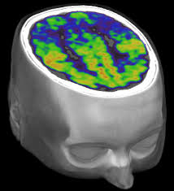
CT images
CT delivers a series (stack) of transversal images (slices), in the plane of the CT scanner.
©
dr. Chris R. Mol, BME, NORTEC, 2015

Slide 8
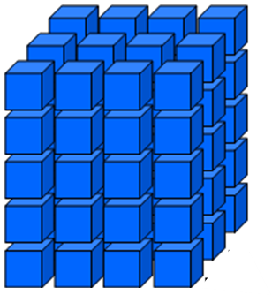
Calculating images in different cross sections
A stack of ‘transversal’ slices (axial) form together a 3-dimensional (3D) data set, containing a digital value in each 3D pixel (e.g. a 1x1x1 mm cube).
From such a 3D data set, one can calculate & display new cross sectional images, e.g. in sagittal and coronal cross sections.
Further image processing to detect the boundaries/edges of specific organs leads to 3D images.
©
dr. Chris R. Mol, BME, NORTEC, 2015

Slide 9
MRI
Magnetic Resonance Imaging
Resonance of the protons in the body
dr. Chris R. Mol, BME, NORTEC, 2016

Slide 10
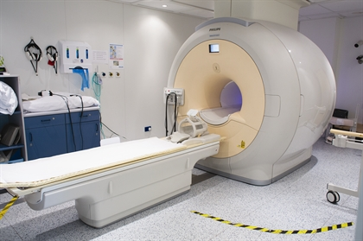
MRI principles
MRI scanners do not use X-ray, but strong magnetic fields, radio waves, and magnetic field gradients to form images of the body
In a strong magnetic field, the hydrogen protons in body tissues are aligned.
When an electromagnetic (radio) wave pulse is transmitted, this disturbs the axis of rotation of these protons.
Following the electro-magnetic pulse, radio signals are generated by the body tissues as the protons return to their baseline state.
These radio signals from the body are often collected by small antennae, called coils, placed near the area of interest.
Effectively MRI makes images of the hydrogen protons (the concentration of water) in the different body tissues.
Patient table
Magnet
Head Coil
So far there is no evidence that this method does any damage to body tissues
©
High-end Medical Imaging
dr. Chris R. Mol, BME, NORTEC, 2016

Slide 11
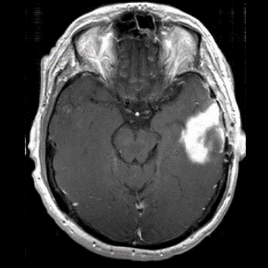
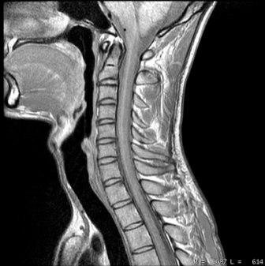
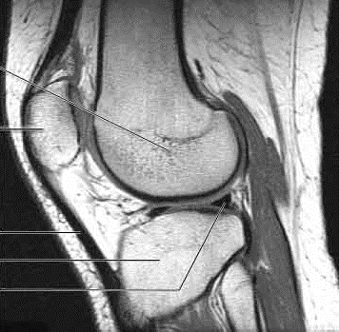
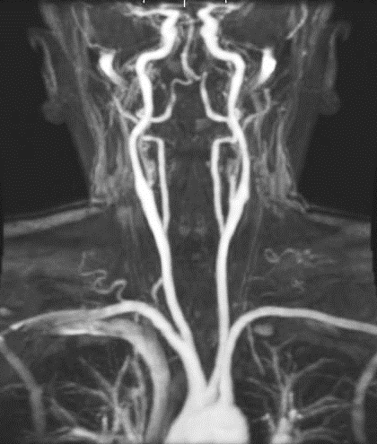
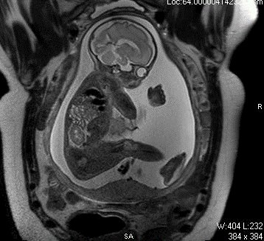
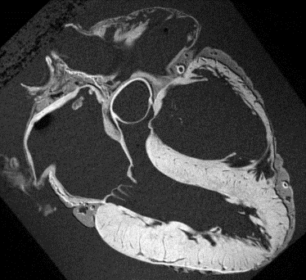
MRI use
Because soft tissues often have differences in their water content, Magnetic Resonance (MR) images show excellent soft tissue contrast. This allows clinicians to clearly see the details of tissue structure and to distinguish normal from diseased tissue in order to diagnose and track the progress and treatment of disease.
Because of the strong magnetic fields that are used, MRI cannot be used for patients with pacemakers and other implants that contain a metal.
MRI is frequently used in musculoskeletal radiology and neuroradiology
©
High-end Medical Imaging
dr. Chris R. Mol, BME, NORTEC, 2016

Slide 12
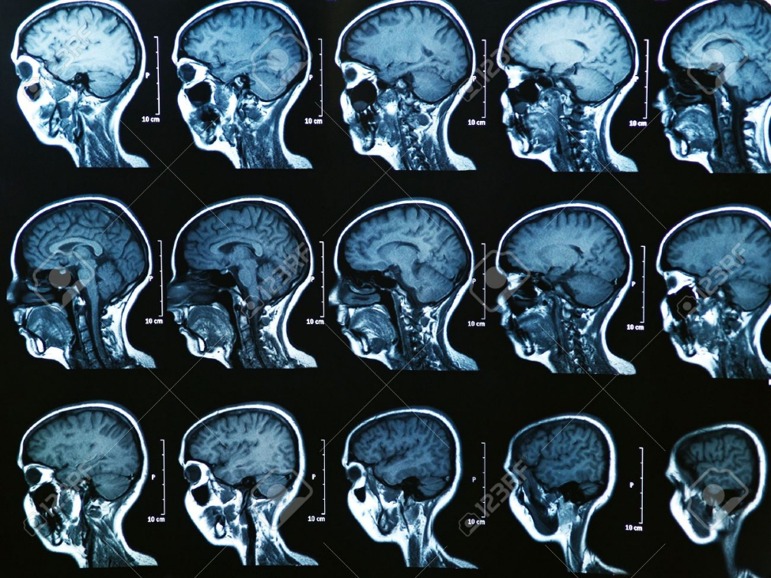
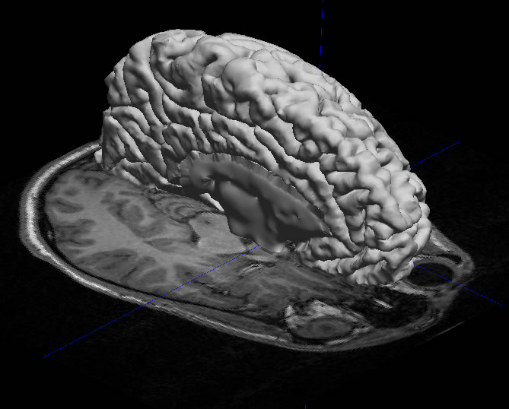
MRI image display
MR allows making direct images stacks in all directions: axial, sagittal, coronal or anything in between.
Also, 3D images can be constructed.
©
High-end Medical Imaging
dr. Chris R. Mol, BME, NORTEC, 2016

Slide 13
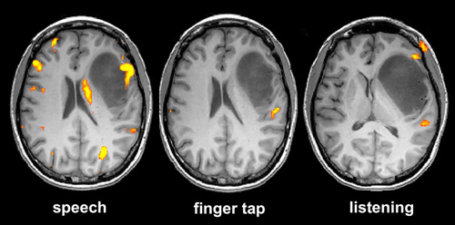
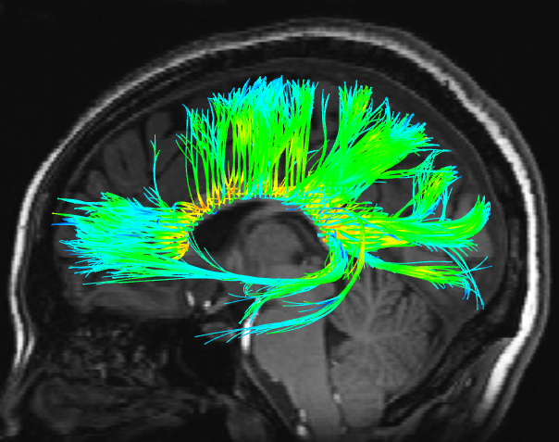
MRI application in brain research
Functional MRI (fMRI) is a ‘functional’ neuro-imaging procedure using MRI technology that measures brain activity by detecting changes associated with blood flow. This technique relies on the fact that cerebral blood flow and neuronal activation are coupled. It is used for research on the functioning of the brain.
Diffusion Tensor Imaging measures where the properties of brain tissue are not the same in all directions. This is the case for nerve bundles: the wiring of the brain.
Functional MRI
showing brain areas that are activated with certain patient activities
Diffusion Tensor imaging
showing nerve bundels in the brain
©
High-end Medical Imaging
dr. Chris R. Mol, BME, NORTEC, 2016

Slide 14
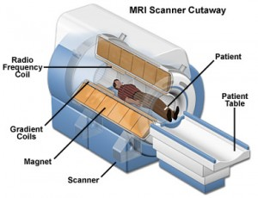
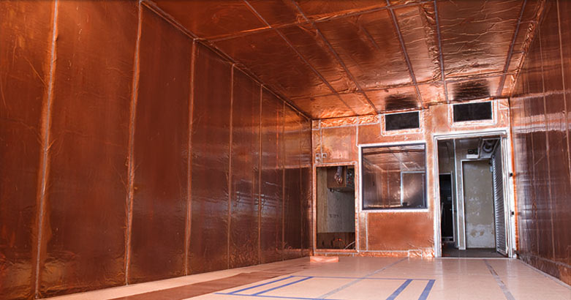
MRI technology
MR systems use different magnetic field strengths: from 0.1 to 3.0 Tesla. A 1 Tesla field is 20,000x stronger than the earth magnetic field. Stronger magnets give better image quality but are (much) more expensive.
Metal objects (screw drivers!) must be kept out of the neighbour-hood of MR scanners. They will be jumping into the magnet.
Often, heavy shielding is required to reduce the magnetic field to acceptable levels outside the MR room.
The strong magnetic fields are usually generated by means of high electric currents through wires running around the patient. In order not to generate a lot of heat, the magnet wires are cooled to close to zero degrees Kelvin (-273ºC), so that the wires become super conducting: the wires have zero resistance at this temperature and no heat is created. For the cooling, liquid Helium is used. This must be regularly added (‘consumable’).
©
High-end Medical Imaging
dr. Chris R. Mol, BME, NORTEC, 2016

Slide 15
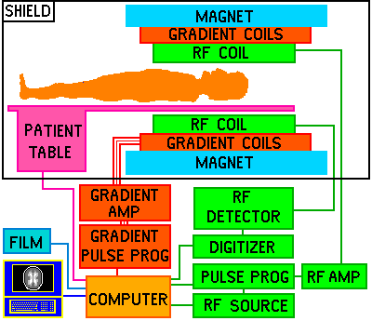
MRI maintenance
MRI scanners are even more complex than a CT scanner or an X-ray system. No chance to fix anything outside the obvious if you are not a well-trained specialist. A modern MR scanner has a lot of ‘service software’ on board to help the service engineer diagnose the system. This software is usually not accessible for the user.
Maintenance contracts are obligatory.
©
High-end Medical Imaging
dr. Chris R. Mol, BME, NORTEC, 2016

Slide 16
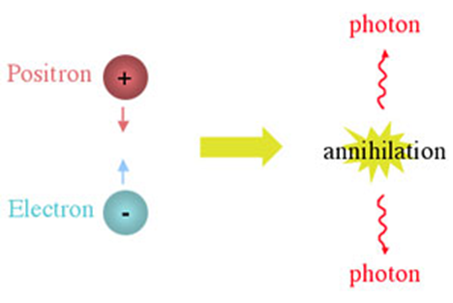
PET
Positron Emission Tomography
The positron or anti-electron is the anti-particle of the electron. The positron has an electric charge of +1e and has the same mass as an electron. When a low-energy positron collides with a low-energy electron, annihilation occurs, resulting in the production of two or more gamma ray photons.
dr. Chris R. Mol, BME, NORTEC, 2016

Slide 17
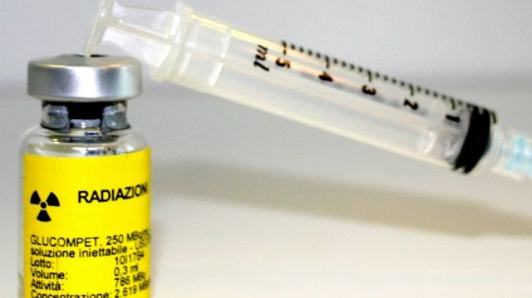
PET principles
In PET applications a small amount of specific radio-active pharmaceuticals is injected into a patient. These pharmaceuticals spread throughout the body, but especially concentrate in specific organs/tissues, depending on the pharmaceutical used.
In PET, the radio-activity means that positron particles are emitted by these pharmaceuticals.
The positrons emitted from the pharmaceutical collide with free electrons in the body, get annihilated and emit 2 gamma photons in exactly opposite directions. These gamma photons are detected by the crystals in the PET scanner. The crystal is a scintillator that converts gamma photons into visible light. Only when two gamma photons are detected at the same time, it is counted as an ‘event’.
After collecting such events over a significant period of time (30-60 minutes), cross-sectional images are made.
©
High-end Medical Imaging
dr. Chris R. Mol, BME, NORTEC, 2016

Slide 18
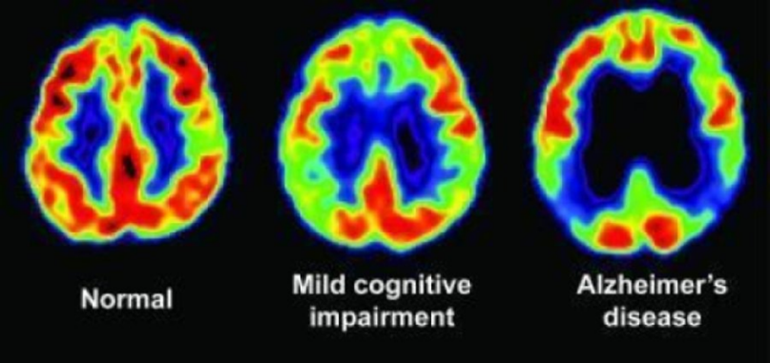
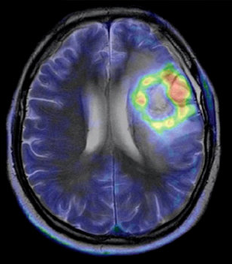
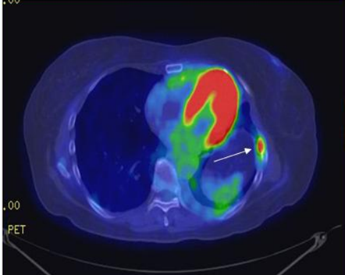
PET use
PET images of the brain in different patients
PET images do not indicate anatomy of the body, as CT and MR, but (bio-chemical) activity. This gives different information which is used to diagnose a patient.
PET can often detect disease early, compared to MR & CT. It is also used to measure the effectiveness of therapy.
The spatial resolution of PET images is much lower than that of CT or MR. This is because the amount of injected radioactive drugs is limited for patient safety.
PET images can be used in combination with CT or MRI images to view both anatomy and function. This helps to locate e.g. the tumour in the anatomy.
PET is used especially in cardiology, neurology, and oncology.
PET/CT images:
CT is used to show the detailed location of the PET signals
©
High-end Medical Imaging
dr. Chris R. Mol, BME, NORTEC, 2016

Slide 19
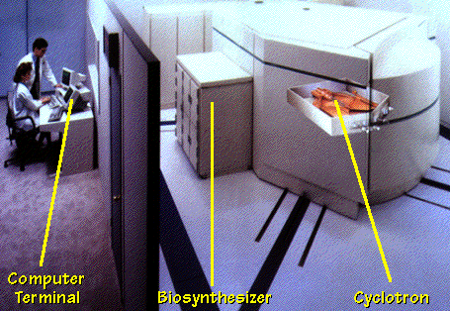
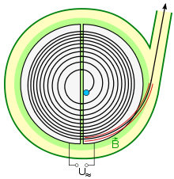
PET production of pharmaceuticals: the cyclotron
The radio-active pharmaceuticals required for PET scanning need to be produced in or very close to the hospital. The reason for this is that the radio-activity decays in a few hours (in order to be effective for the imaging) and long transport times would lose much of the radio-activity. Such production is done with a cyclotron.
A cyclotron is an accelerator of subatomic particles. It produces a large quantity of protons (heavy particles with an electrical positive charge) and gets them moving at an accelerated rate along a circular orbit, inside a chamber controlled by powerful alternating electro-magnetic fields.
Thus, the particles gain energy and are smashed against a target at nearly the speed of light. The atoms of a substance placed in this target are transformed by this bombardment into radioactive, unstable materials by means of a nuclear reaction.
Sketch of a particle being accelerated in a cyclotron.
There are over 1200 cyclotrons used in nuclear medicine worldwide for the production of radionuclides
©
High-end Medical Imaging
dr. Chris R. Mol, BME, NORTEC, 2016

Slide 20
NM
Nuclear Medicine
based on radio-active materials injected into the patient
dr. Chris R. Mol, BME, NORTEC, 2016

Slide 21

NM principles
Nuclear medicine (NM) imaging based on the injection to the patient of pharmaceuticals consisting of substances with affinity for certain body tissues, labelled with radioactive tracer.
PET is a specific example of a NM imaging method but in NM, all sorts of radioactive materials are used (not only for positron generation).
Subsequently, an NM scanner is used to detect the (location of the) radiation emitted from these pharmaceuticals outside the body and to present this as an image.
While anatomical detail (spatial resolution) is limited in these studies, nuclear medicine is very useful in displaying physiological function. For example, the excretory function of the kidneys and the blood flow to heart muscle can be measured.
Different radiopharmaceuticals are used for different clinical applications.
©
Medical Imaging
dr. Chris R. Mol, BME, NORTEC, 2016

Slide 22
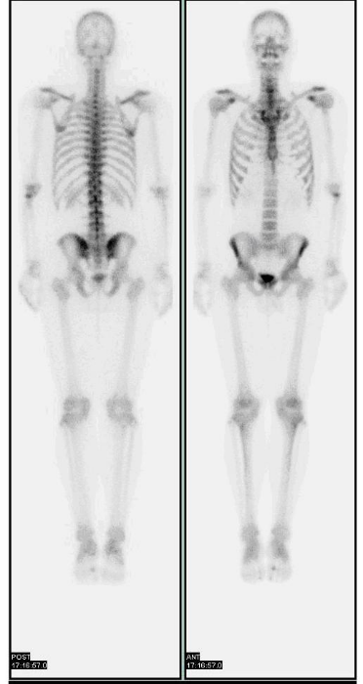
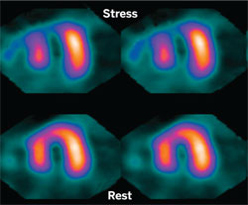
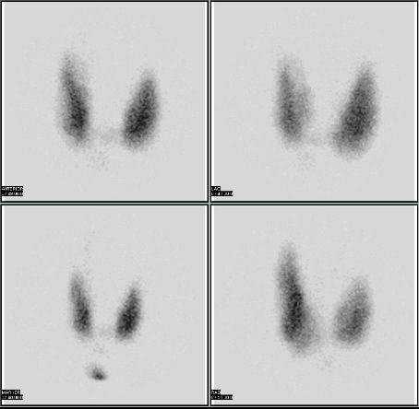
NM Applications (examples)
Thyroid scan for evaluation of hyperthyroidism
(too large thyroid)
Cardiac Technetium study
mapping metabolism in the heart
2D Bone Scan
©
Medical Imaging
dr. Chris R. Mol, BME, NORTEC, 2016

Slide 23
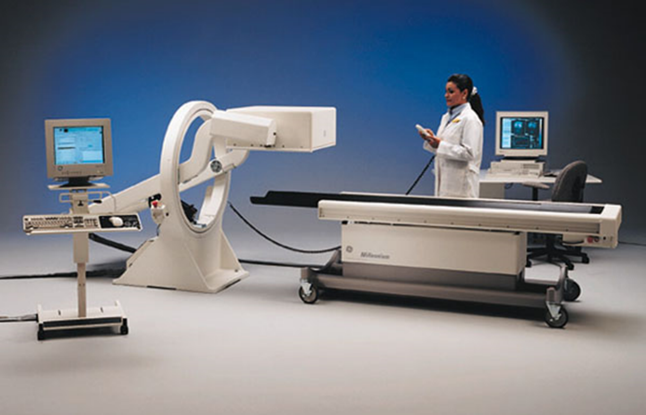
NM principles
A NM scanner or Gamma Camera can be
  static, positioned on one side of the patient, producing projection (2D) images
  or it can be rotating around the patient, producing 3D images
©
Medical Imaging
dr. Chris R. Mol, BME, NORTEC, 2016

Slide 24
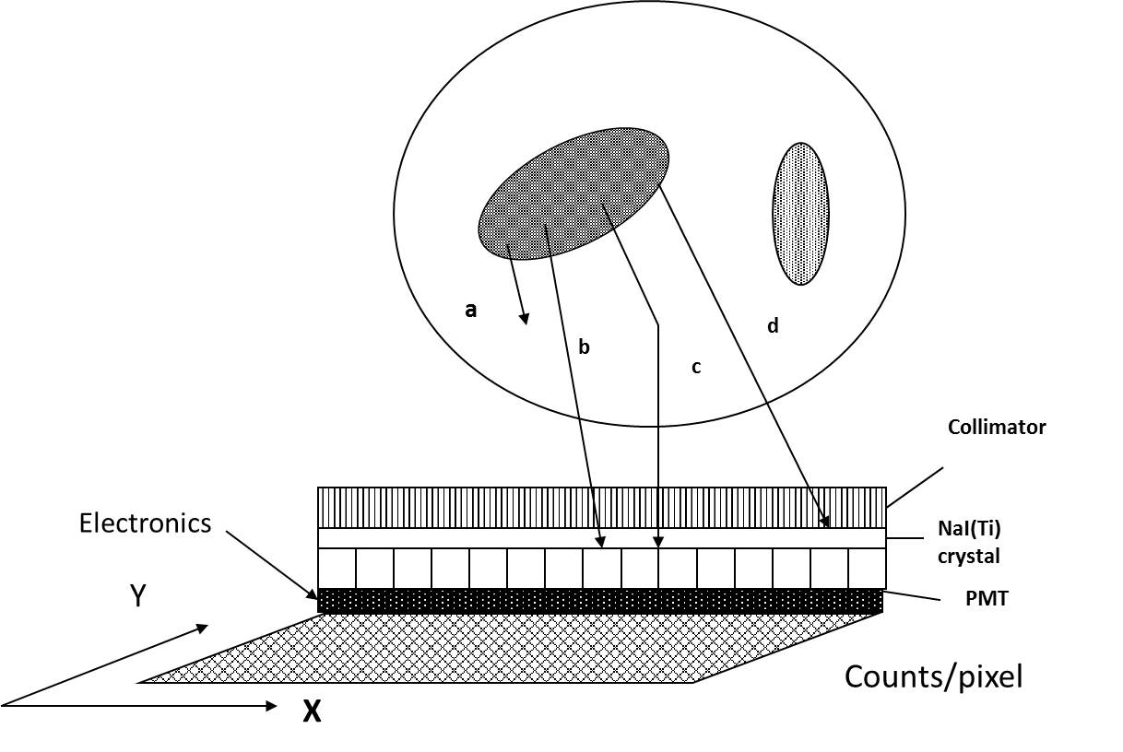
NM: Gamma Camera
The Gamma Camera is a detector for gamma particles (photons), based on a large area (40 cm or so in diameter) NaI(Tl) crystal.
When a photon hits and interact with the crystal, the scintillation generated is detected by an area of Photo Multiplier Tubes (PMTs).
An electronic circuit evaluates the relative signals from the PMTs and determines the location of the signal. From this, an image is constructed.
©
Medical Imaging
dr. Chris R. Mol, BME, NORTEC, 2016

Slide 25
Other
dr. Chris R. Mol, BME, NORTEC, 2016

Slide 26
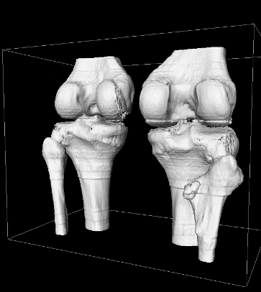
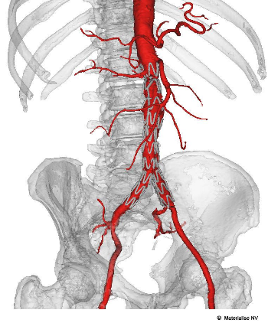
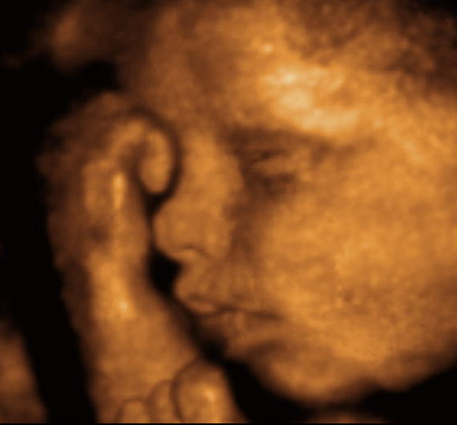
3D Reconstruction and display
Imaging Methods like Magnetic Resonance (MR), Computerized Tomography (CT) and 3D ultrasound result in 3D data sets, which can be analysed by software programs and displayed to yield spectacular information which cannot be seen by a human observer from the original images.
©
Biological Signal Processing
dr. Chris R. Mol, BME, NORTEC, 2015

Slide 27
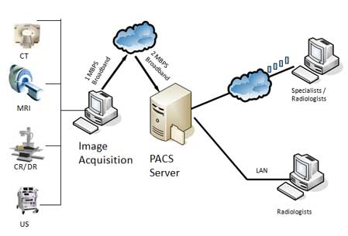
Teleradiology
Teleradiology is the transmission of medical (X-ray) images from one location to another for interpretation by a trained professional. It can be used to allow rapid interpretation of emergency room examinations after hours of usual operation. It can also be used to support small hospitals in rural areas which have an X-ray system, but no radiologist.
Teleradiology requires a sending station, an internet connection, and a high-quality receiving station. At the transmission station, plain radiographs are passed through a digitizing machine before transmission, while CT, MRI, ultrasound and nuclear medicine scans can be sent directly, as they are already digital data. The computer at the receiving end will need to have a high-quality display screen. Reports are then transmitted to the requesting clinician.
Teleradiology is gaining wide popularity, also in developing countries.
©
Medical Imaging
dr. Chris R. Mol, BME, NORTEC, 2016

Slide 28

END
The creation of this presentation was supported by a grant from THET:
see https://www.thet.org/

